Slide 1


K-12 School Shootings In The United States
BHAVIKA SHARMA
PRAVALLIKA PENTAPATI
SAHIL DHINGRA
SUMMER 2022
YouTube Link: https://youtu.be/YuCwZdd7TsY

Slide 2
Agenda
Background
Motivation
Visualization Methods Considered
Process
Results
Insights
Future Work
References

Slide 3

Background
Injuries from gunfire at schools are one of the leading causes of fatalities globally and within the US.
Fatal or non-fatal, School shooting incidents not only burden victims and their families with physical and emotional distress but also creates depression and illness.
School shooting incidents are estimated 3 million children (about the population of Arkansas) are exposed to gunfire per year in the US (United States).
American children are exposed to gun violence at schools is just the tip of the iceberg–every year.
According to the Center for Homeland Defense and Security, there have been more than 2,000 school shootings in the United States since the 1970s with 700 killed.

Slide 4
Background
The trend in the number of incidents every year appears to be not slowing down. The most common contributing factors to school shootings
Social rejection
Mental illness
Dispute/grievance related
Availability of guns and consumption of violent media(especially violent video games, shows and films)

Slide 5
Motivation
The motivation behind this project is to identify the trends and patterns associated with the school incidents and provide observations with easy-to-understand visualizations.
It is high time we should do something substantial to save our kids from the gun violence in schools, which is now the leading cause of death among children and teens in the United States.

Slide 6

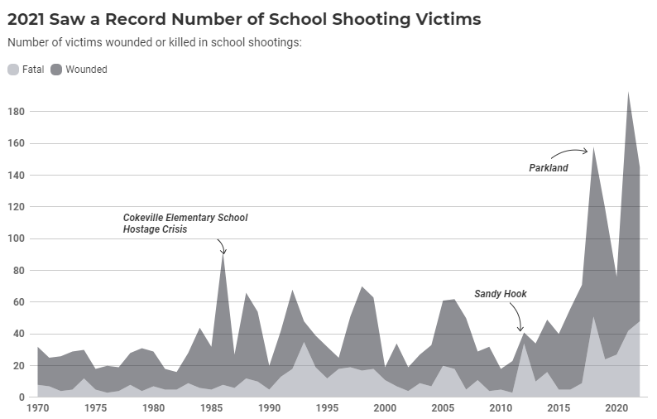



Existing Visualizations
Example-1:
The visualization uses a K-12 school shooting database that illustrates the distribution of shootings across different states of the U.S.A from 1970 to 2022.
Simple chart and a good overview of year vs incidents count.
It’s evident that year 2015 to the present there has been a significant increase in school shootings and 2021 was the most violent on record with 193 people killed in school shootings.

Slide 7
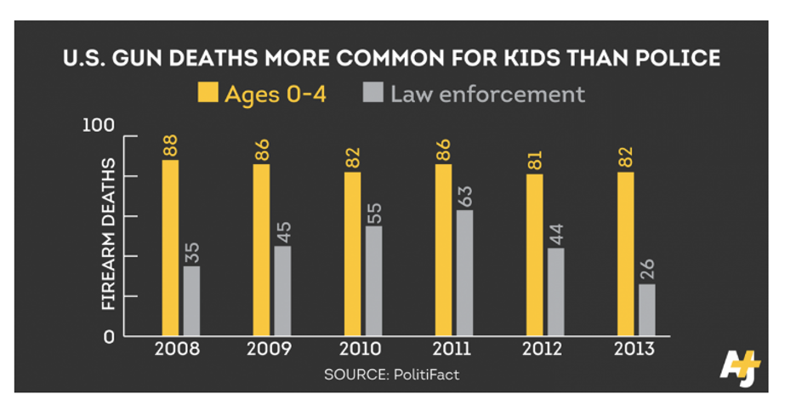
Example-2:
This Visualization is displayed as a Bar chart and basically represented more common deaths for kids ages zero to four than the police due to gun fire.
The visualization is good. The parallel bar charts help us to see the comparison promptly
numbers populated for both kids and law enforcement from the timeline 2008 to 2013. It has enough data to draw a conclusion that kids are not safe

Slide 8
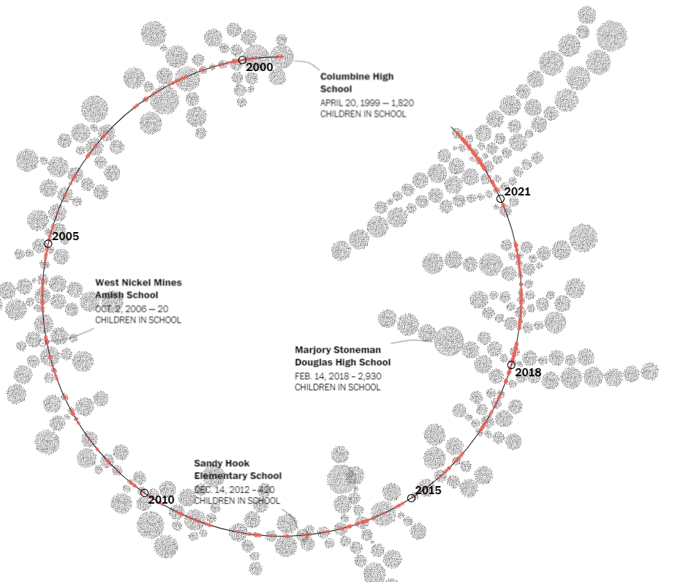
Example-3:
The visualization presents a time series in form of a spiral that starts from the year 1999 to the current incident of 2022. Each dot represents 10 children exposed to gun violence.
The visualization is quite effective as the diverging circles from the spiral shows where in time we have close incidents

Slide 9
Objectives
Our team identifies patterns from the available historical data and conveys the patterns with data visualizations that are easier to understand.
Using a dataset to know exactly where shootings have taken place on school property and help when designing security systems and planning emergency procedures at specific locations where a shooting took place

Slide 10
Visualization Methods Considered
Methods used for the project include bar charts, histograms, and geospatial charts. Bar charts were mainly used to provide an overview of the data, compare different parameters and identify patterns at the same time
Histogram charts are used to display the distribution of shooters’ and Victim’s age.
Geospatial plots were used to display the shooting incident locations based on latitude and longitude.
All the visualizations produced for the project considered low ink-to-data ratio and easy-to-understand visualizations as were explained in the coursework.

Slide 11





Process - Highlights
Dataset
Exploratory analysis
Time, Incident, Shooter, Victim, Weapon based analysis
Incidents by geography
Comparative study

Slide 12
Dataset
US school shootings data from K-12 shooting database
A countrywide school shooting incident dataset from 1970- 2022
Few Details on Dataset
The dataset consists of school shooting data from 50 states.
Incident Profile: it consists of Incident ID number details, city, state, location, situation etc.
Shooter Profile: It consists of information about the shooter like age and race.
Victim Profile: It consists of information about the victim.
Weapon Profile: It consists of details about the weapon used by the shooter during the incident.

Slide 13
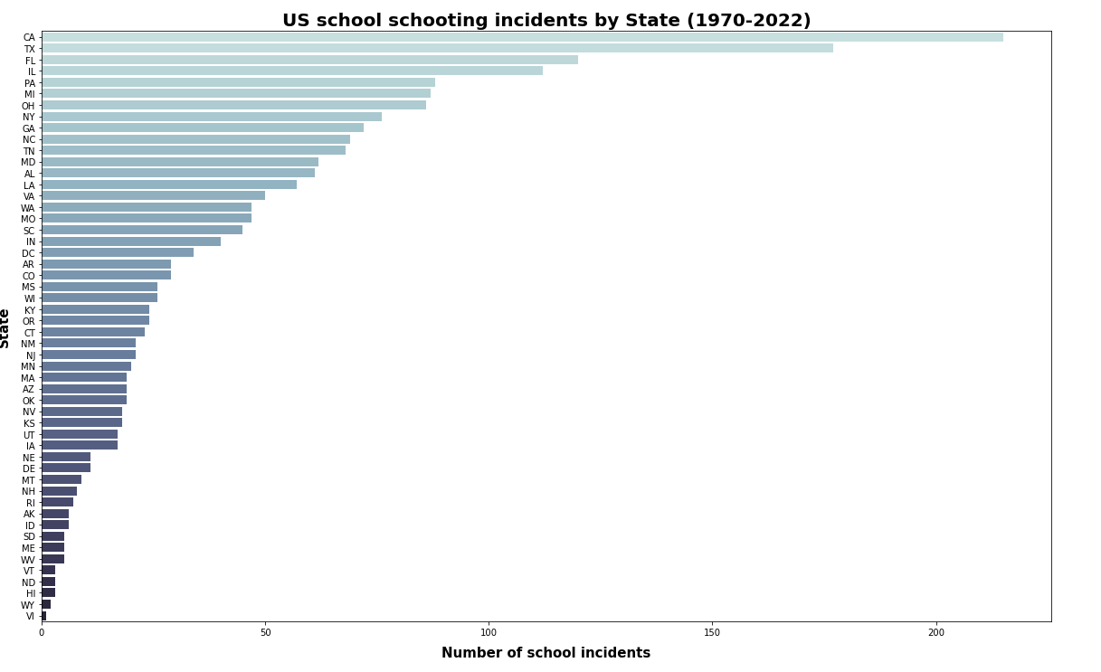
Exploratory Analysis
Bar chart to understand the count of incidents for all 50 states in the united states

Slide 14
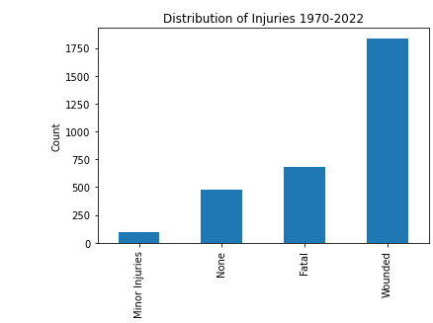
Injuries count
Visualization represents the count of injuries for school shootings from 1970 -2022 in the United States.
As per this graph, it is evident that there are more victims with wounded during the school shootings.

Slide 15
Results and Insights
Incident
Shooter
Victim
Weapon
Is School shooting seasonal?

Slide 16
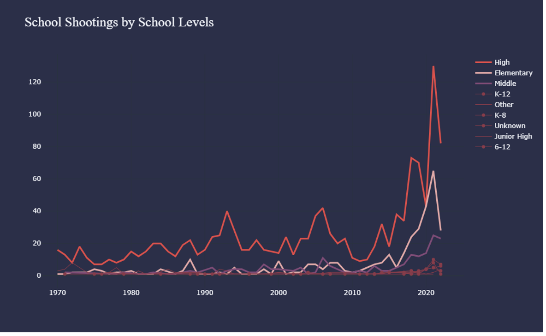

Incidents
State Wise : The top 10 states for school shootings are California, Texas, Florida, Illinois, Michigan, Ohio, New York, Georgia and North Carolina. It seems the most populous states like California and Texas have had the largest number of shootings that resulted in deaths or injuries
City wise :Chicago and Los Angeles ranked highest in the school shooting .
School Level Wise : Highest school shootings hit for high school level following the elementary school, Middle, K-12, Other, K-8,Junior high school levels.

Slide 17
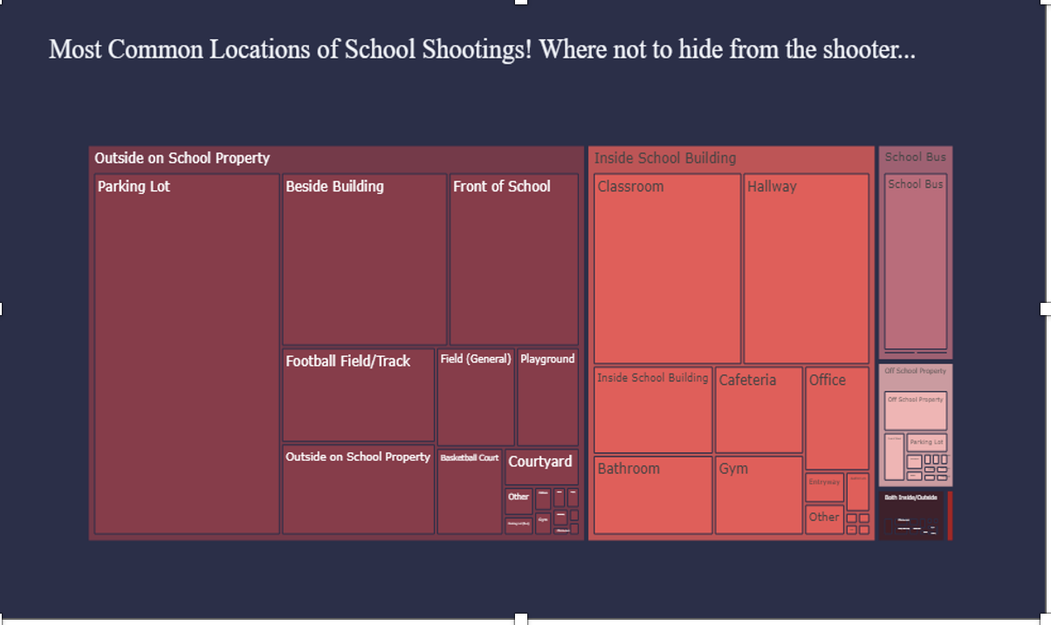
Incidents
Location wise :The most common location for a school shooting is in a parking lot followed by a classroom.
They are 1086 incidents occurred outside on school property and 672 occurred solely inside a school building

Slide 18
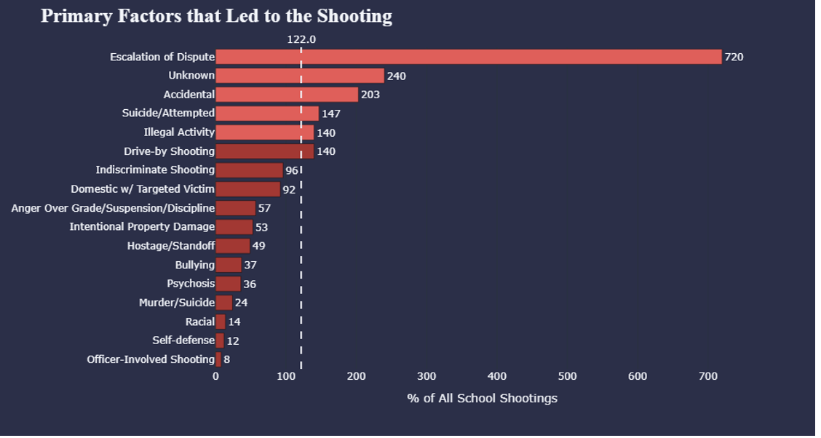
Incidents
Factors leading to shooting : There are a total of 720 incidents that were the result of an escalation of dispute which is reported as the highest number of incidents reported followed by Accidental (203) incidents reported. Most shooting resulted from disputes or grievances, for example, between students or staff, or between gangs

Slide 19
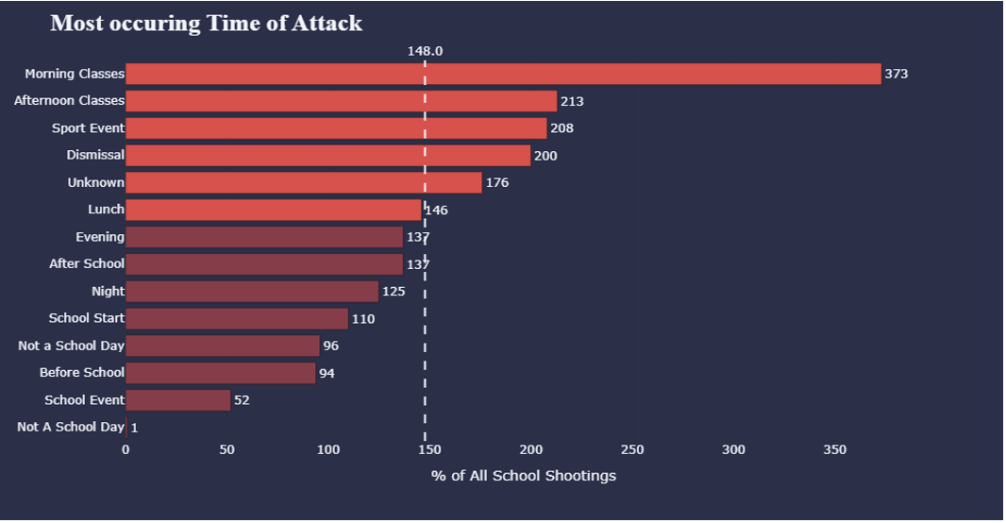
Incidents
Time of Attack : Most school shootings occurred in the morning (373), followed by afternoon classes (213) It seems students are leaving campus in the afternoon and during late-night arguments in school parking lots. shootings can happen any time and they are happening more often during the morning, as classes begin, or around dismissal time.

Slide 20
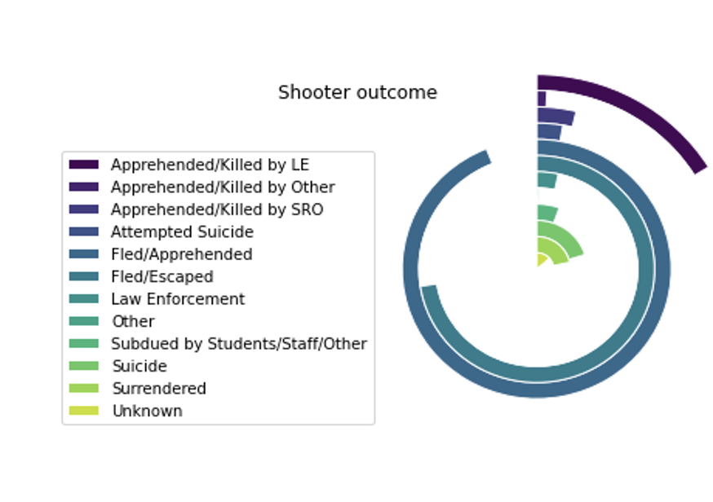
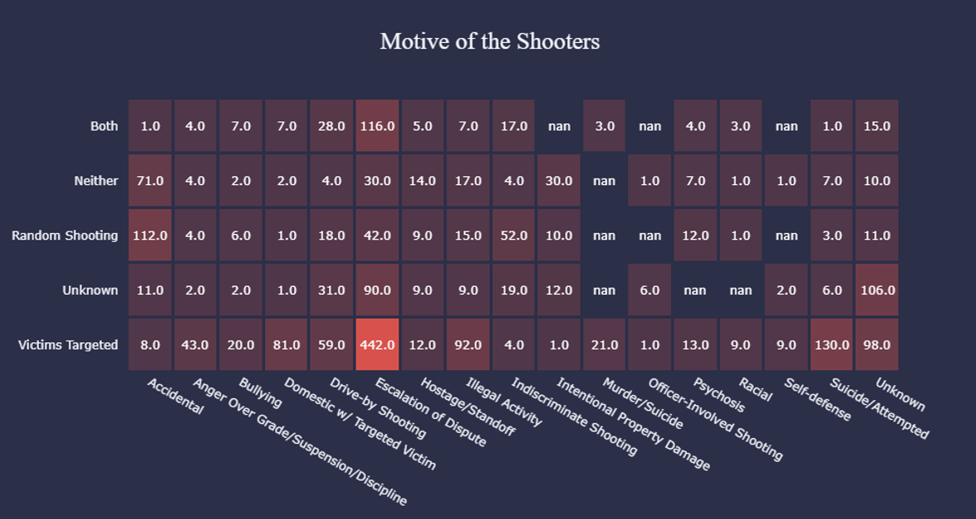
Shooter
Age wise and Gender wise : Age of a shooter varied from 5-year-old to 78 years old. Average Age of shooter is around 15 years. There are 14 cases where the age of the shooter is from 5-9 years old. Gender wise shooters are predominantly male.
Motive wise :As evident, most shootings were driven by intense escalation of dispute with shooters with intention to target their victims.
Outcome Wise :Most shooter fled the scene around 62% and those who came for mass shootings were looking for suicide or attempted suicide before. In only 62 cases , the law enforcement was able to tackle the scene which is so low.

Slide 21
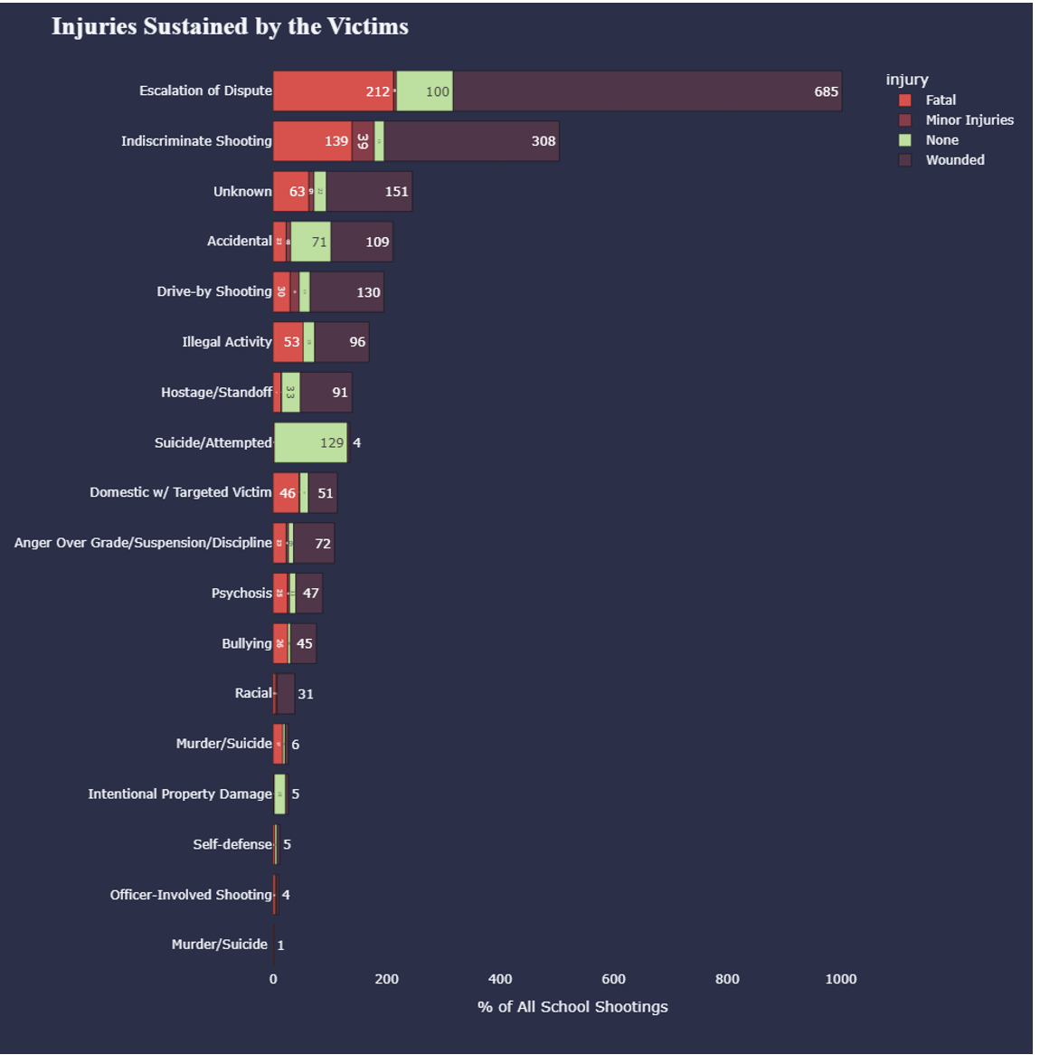
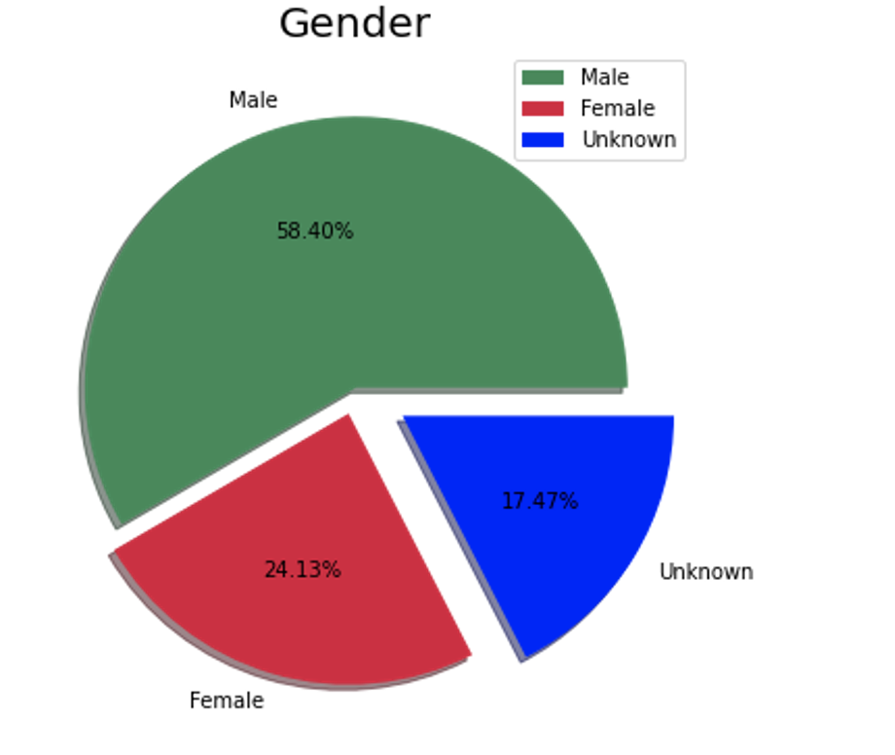
Victim
Demographic wise :As per Demographics , the Male are more likely to be the victim and 60% of victims are students.
Gender and Age wise: Between 1970 to 2022 school shootings happened to more teens around 535 victims followed by ~16-year-old around 289 victims were reported. About 58.40% were male victims but about 20% of data is unknown to us.
Injury wise : more victims are killed(209) with result of escalation of dispute following by 138 victims were killed and 294 victims were wounded with result of indiscriminate shooting at schools since 1970 this two-situation reported highest number of victims got injuries compared to any other

Slide 22
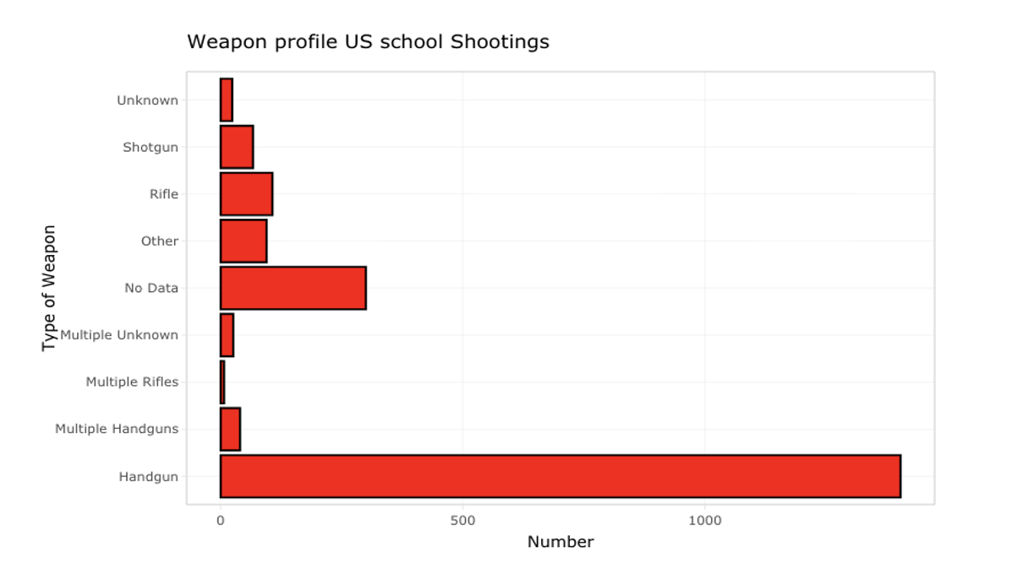
Weapon
Weapon Wise : About 80% of shooting was executed by handguns , we have no data for about 15% of the shootings. 4.5% cases has other weapons.

Slide 23
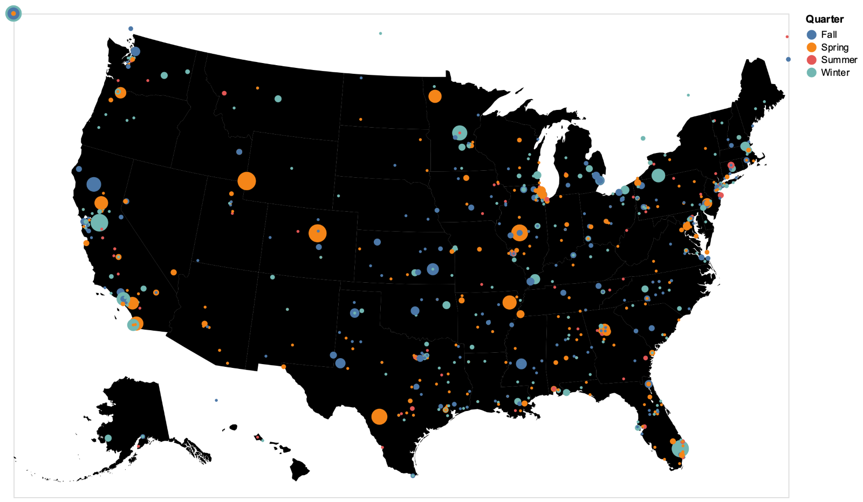
Is School shooting seasonal?
What are we trying to show?
Shootings per quarter/Season
Months with most shootings.
Weeks with most shootings.
Weekdays/time with most shootings.
Shootings per season (1970-2021)

Slide 24
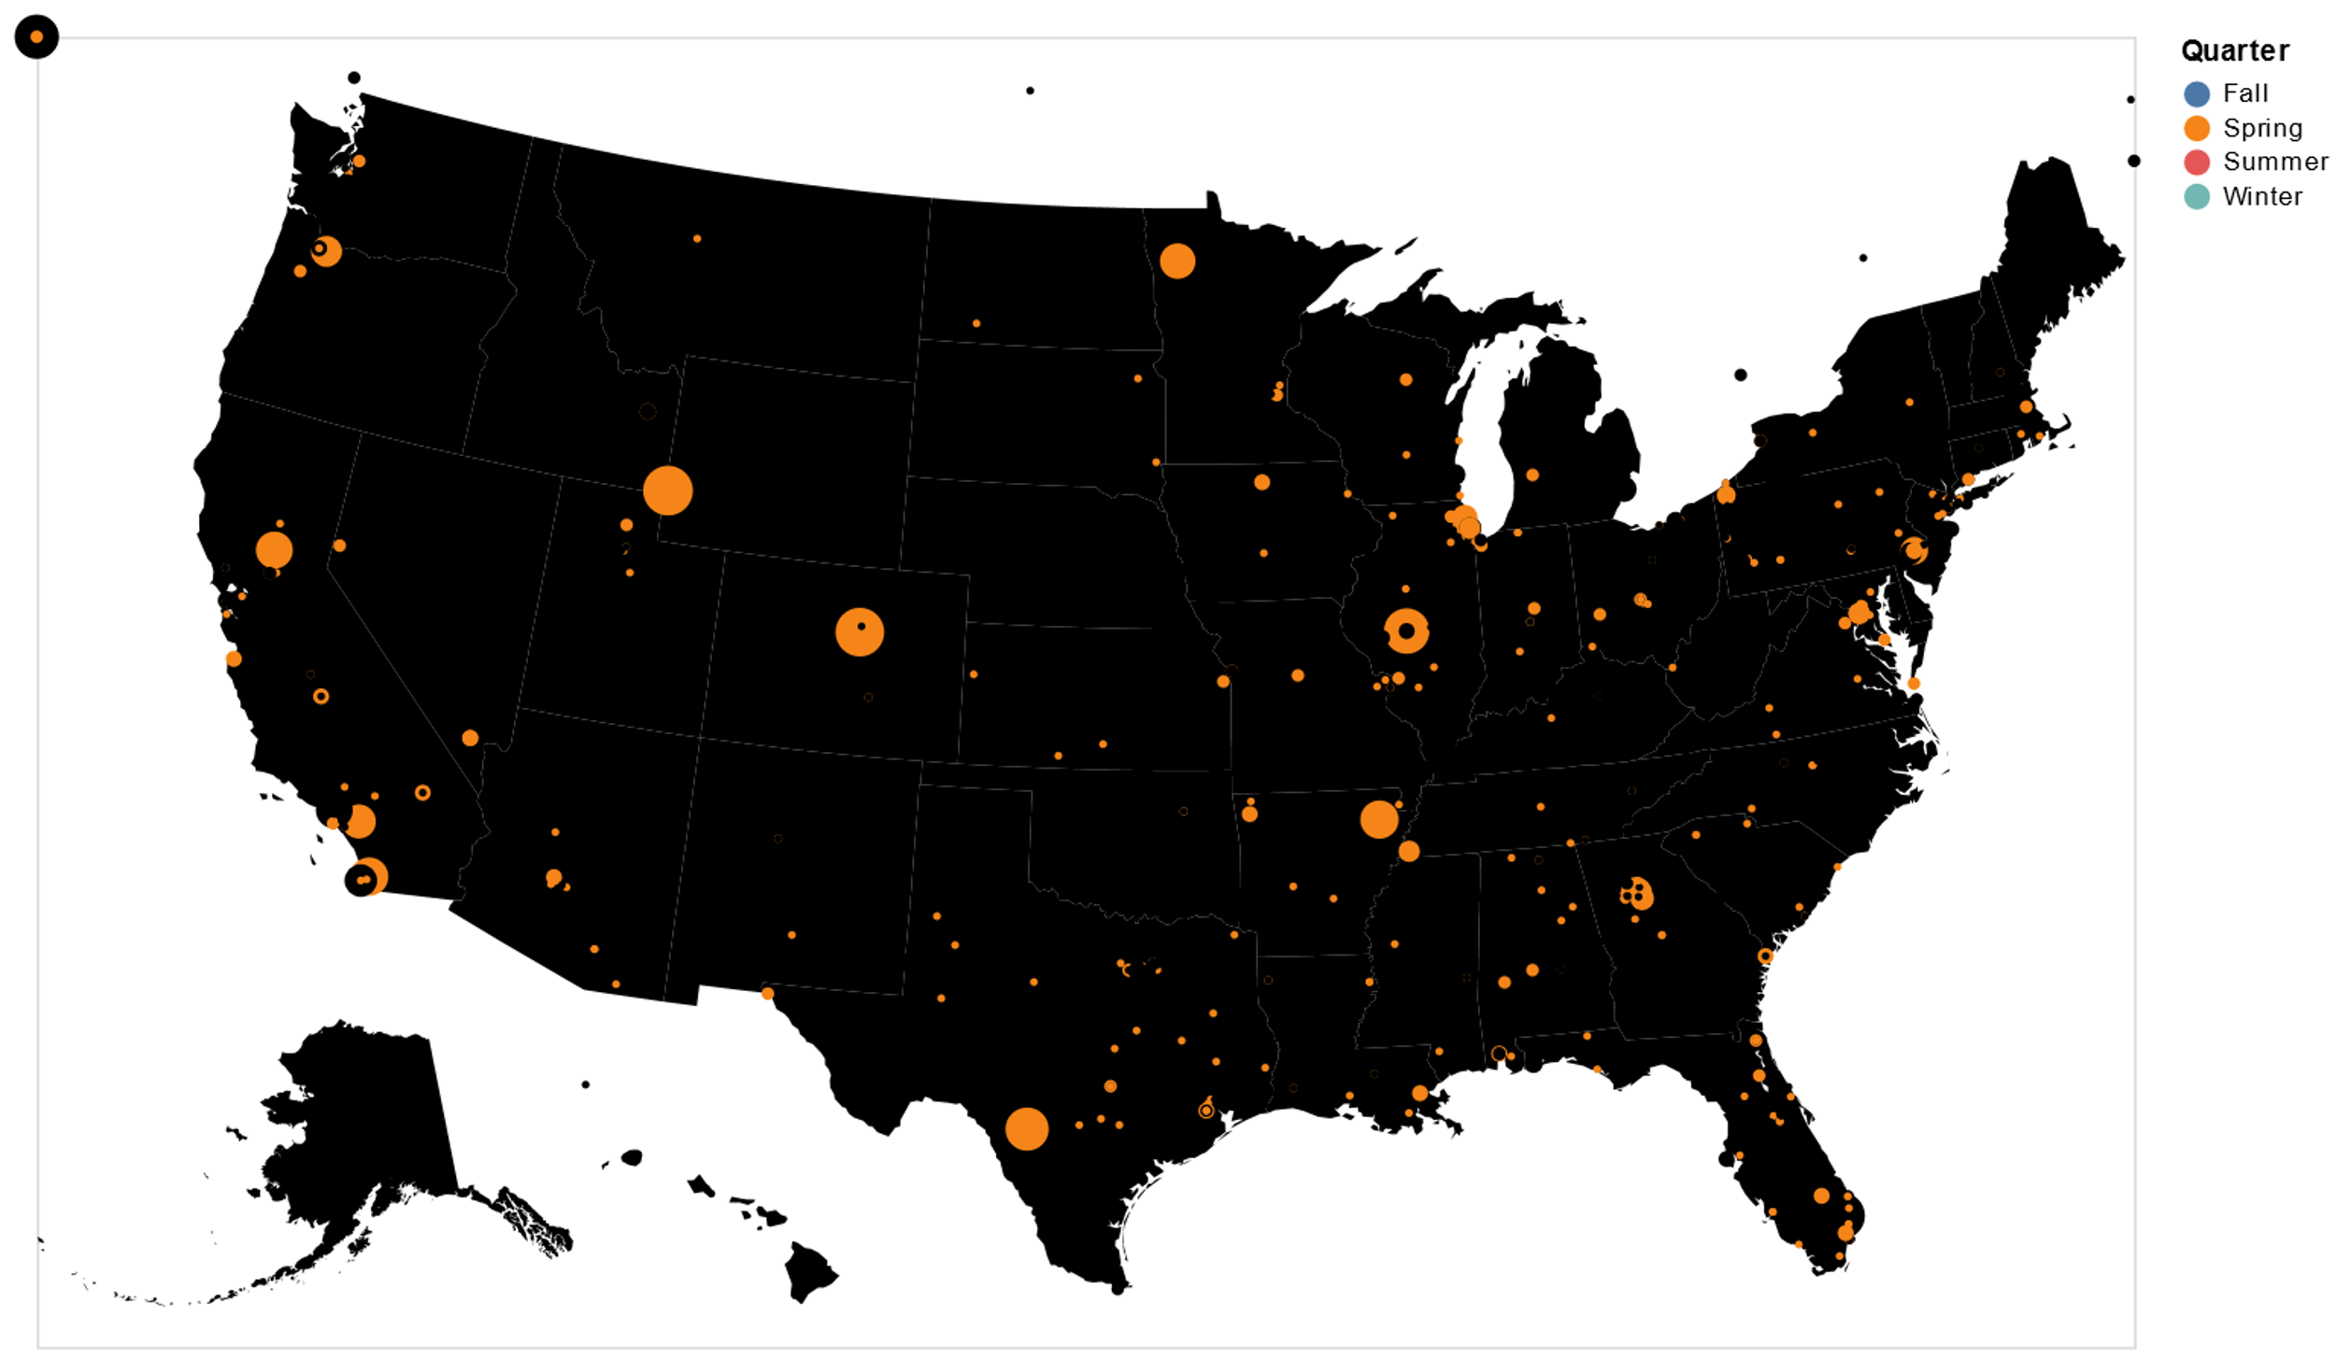
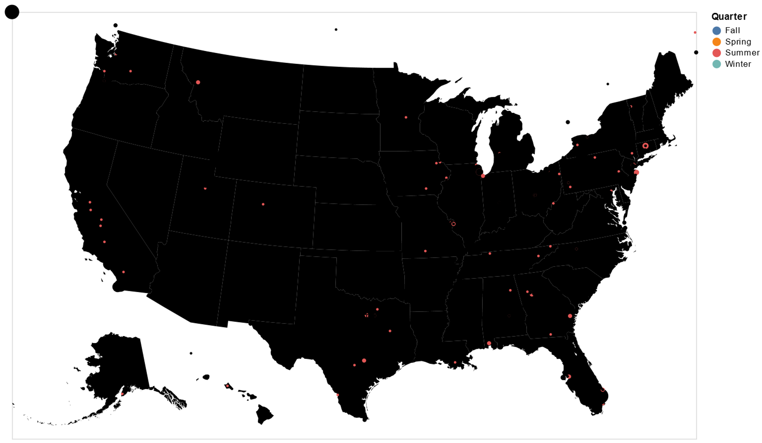
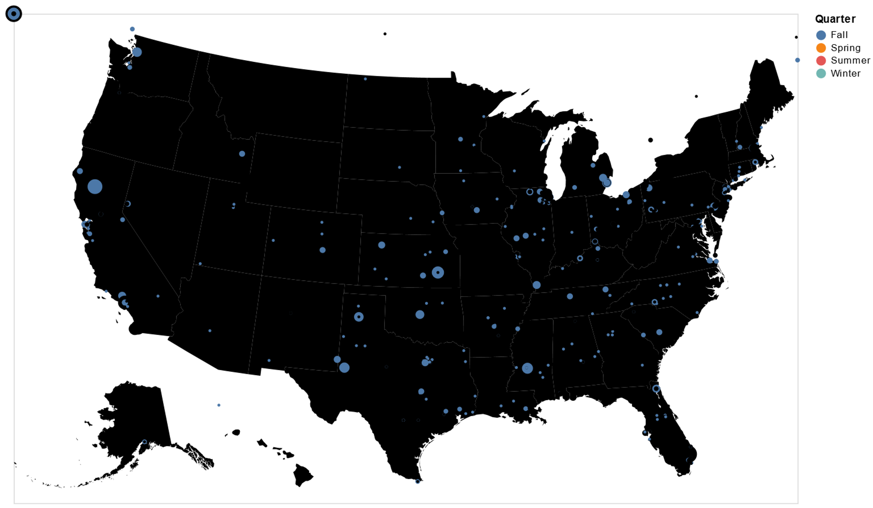
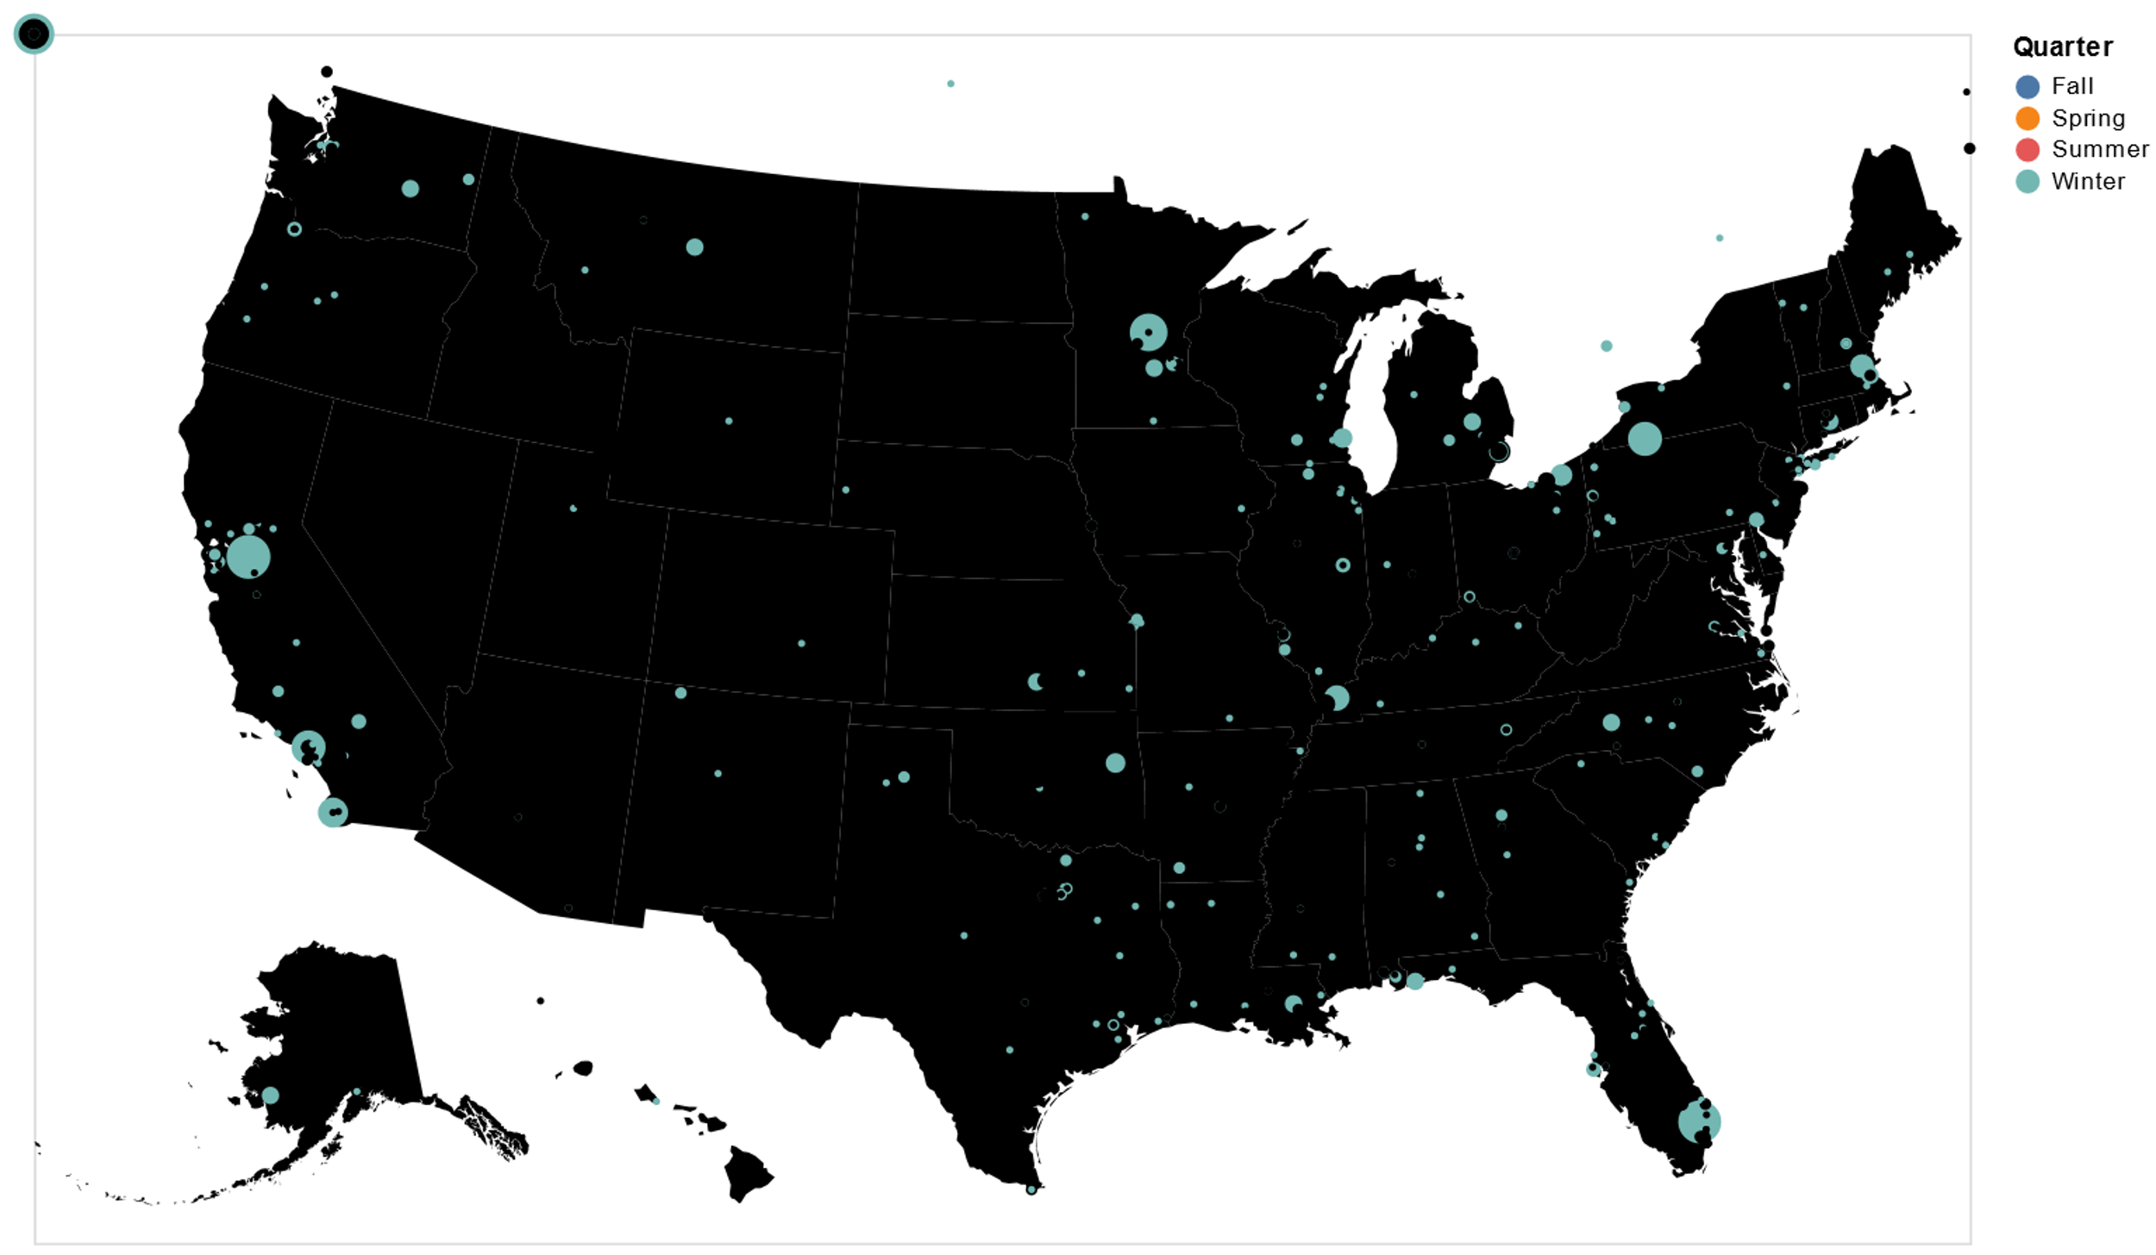
Shootings each Season Spring – Summer – Fall - Winter
SPRING |  | SUMMER |  | FALL |  | WINTER
INCIDENTS | 558 | INCIDENTS | 221 | INCIDENTS | 703 | INCIDENTS | 586
VICTIMS | 969 | VICTIMS | 263 | VICTIMS | 969 | VICTIMS | 903
Victim/Incident Ratio | 1.73 | Victim/Incident Ratio | 1.19 | Victim/Incident Ratio | 1.37 | Victim/Incident Ratio | 1.54
VICTIMS : 1808 MALES Avg Age of Victims : ~10
541 FEMALES Avg Shooter age : Teen (~15)
747 NO DATA

Slide 25
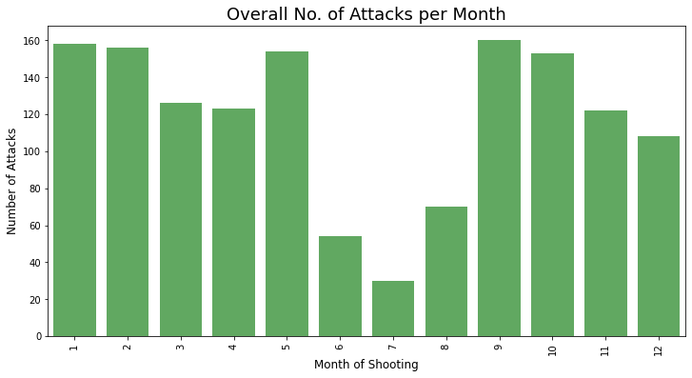
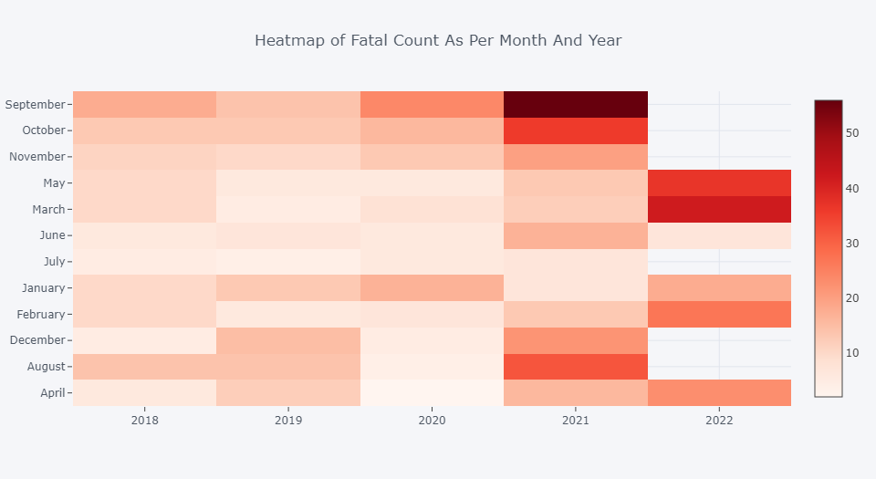
Shooting per Month
BIMODALITY : High in Winter, Spring, then dip in summer, again high Fall onwards.
Most shootings: JAN, FEB, MAY, SEP, OCT. (BEFORE/AFTER VACATIONS).
Least shootings: JUN, JUL, AUG. Goes Down towards end of the year. (Vacation times)
# Last 5 Years Below (2022 half year data.)
Month | Incidents | victims
Jan | 224 | 339
Feb | 203 | 324
Mar | 186 | 250
Apr | 168 | 250
May | 204 | 471
Jun | 82 | 93
Jul | 47 | 54
Aug | 118 | 144
Sep | 265 | 352
Oct | 233 | 328
Nov | 177 | 250
Dec | 161 | 241

Slide 26
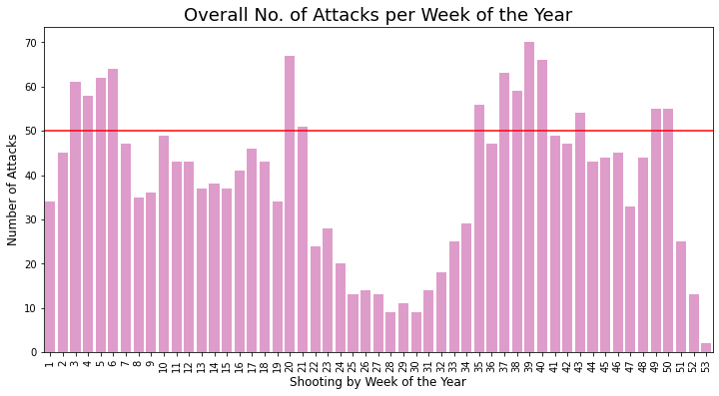
Shootings per Week
BIMODALITY : Inferential to Months.
14 Weeks with > 50 incidents.
Time Frame : Jan 15 - Feb15 .
May
Aug 30 - Oct 31.
Dec 01 - Dec 14.
23 Weeks with incidents between 30-50.
Time Frame : Except Summer and Late Dec.
15 Weeks with < 30 incidents.
Time Frame: May – August (Summers).
Late December.

Slide 27
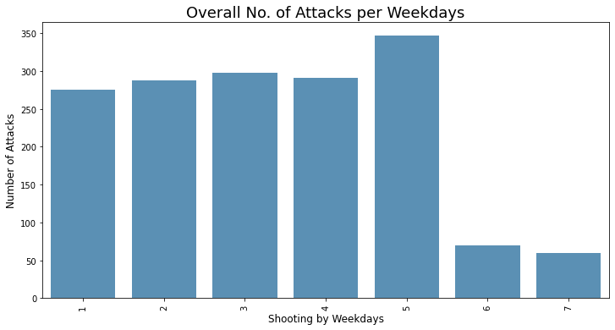
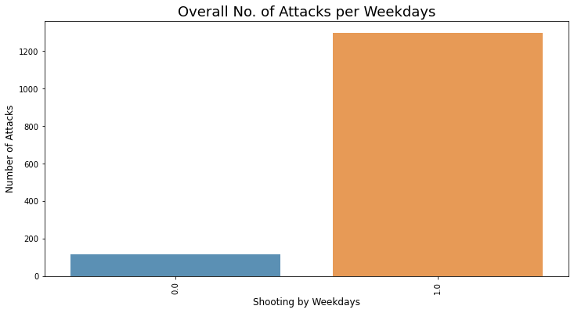
Shooting per day and time
All Days : Most Shootings on Weekdays ~94% Weekends: Least Shootings. ~6%
Fits profile : After and Before holiday. Mostly School games/outside.
Most on : Friday ~22%, 50% more than avg/day.
Time: Morning and afternoon classes.

Slide 28
Insights
2nd common reason of death in US kids.
People are only aware of major shootings.
Shooter: Male, Teen, and Student. Most have history – Bullying, Home Issues.
Most common weapon : Handgun
CA,TX : Biggest states, Most shootings.
Seasonality:
Spring & Winters.
Months: JAN -MAY and AUG –OCT most shootings.
Days: Most shootings on Fridays.
Time: Morning and Afternoon classes

Slide 29
Future Work
Study not totally conclusive. Many Confounding Factors.
Factors needed: Race, Location, Shooter mindset, Cult followers etc.
Further studies required considering all factors.
Machine learning models for predictions.

Slide 30
References
https://www.chds.us/ssdb/
https://www.usnews.com/news/best-states/articles/2022-05-27/states-with-the-most-school-shootings
https://www.gao.gov/assets/gao-20-455.pdf
https://statmodeling.stat.columbia.edu/2020/01/18/graphs-of-school-shootings-in-the-u-s/
https://everytownresearch.org/maps/gunfire-on-school-grounds/
https://www.gannett-cdn.com/GDContent/mass-killings/index.html#explore
https://www.storybench.org/mass-shooting-data-visualizations/
https://www.usnews.com/news/best-states/articles/2022-05-27/states-with-the-most-school-shootings
https://www.washingtonpost.com/graphics/2018/local/school-shootings-database/
https://www.campussafetymagazine.com/safety/k-12-school-shooting-statistics-everyone-should-know/
https://www.cnn.com/2019/07/26/opinions/school-shootings-research-rosenberg/index.html
https://www.washingtonpost.com/local/the-strange-seasonality-of-violence-why-april-is-the-beginning-of-the-killing-season/2016/04/03/4e05d092-f6c0-11e5-9804-537defcc3cf6_story.html

Slide 31
THANK YOU
THANK YOU!

